Slide 1
Scenario W
Group 17

Slide 2
Introduction
Bio-signals are electrical signals produced by living things that can be measured
Goal: Design a develop a bio-signal based human machine interface prototype that produces audio-visual outputs based on the bio-signal. We will be picking up is the surface electromyography signal which is correlated with muscle activity.

Slide 3
Contents
Introduction
Timeline and Contribution
Block Diagram
Individual Systems
Power Calculations and Costing Evaluations

Slide 4
System Block Diagram
Outputs
Bar LED
The number of LEDs that light up corresponds with the strength of muscle activity
Pre-Amplifier
Analogue Signal Conditioning
ADC and Control
2 Electrodes
Picks up bioelectrical activity from muscle in response to muscle stimulation
Instrumentation Amplifier
Amplifies the differential of the signal while removing the noise
Bandpass Filter
Filter out the frequencies which are not in the frequencies of the bandwidth of the sEMG
Buzzer
The buzzer will sound when muscle activity is detected
Arduino (ADC)
Converts analog signals to digital signals. Also used to control the behavior of the output
Full-wave Rectifier
Obtain the absolute value of the signal
DRL Circuit
Removes interference from the environment
Motor
The speed of the motor corresponds with the strength of muscle activity
Integrator
Estimate the mean of the signal
Possible inverting amplifier to increase gain

Slide 5
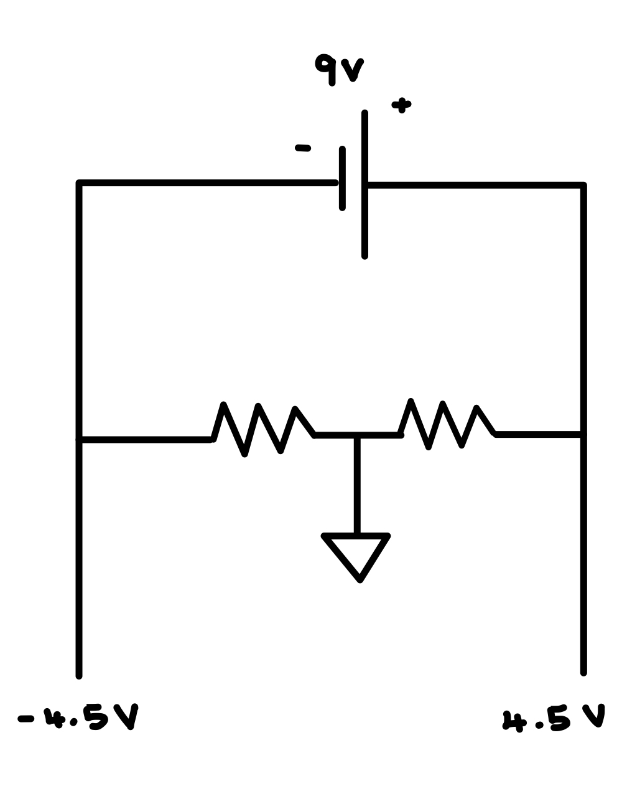
Battery and Op-Amps
A 9V battery is used to power the op-amp
A potential divider circuit is used to supply the positive and negative voltages
1kΩ
1kΩ
Potential Divider Circuit to power op-amps

Slide 6
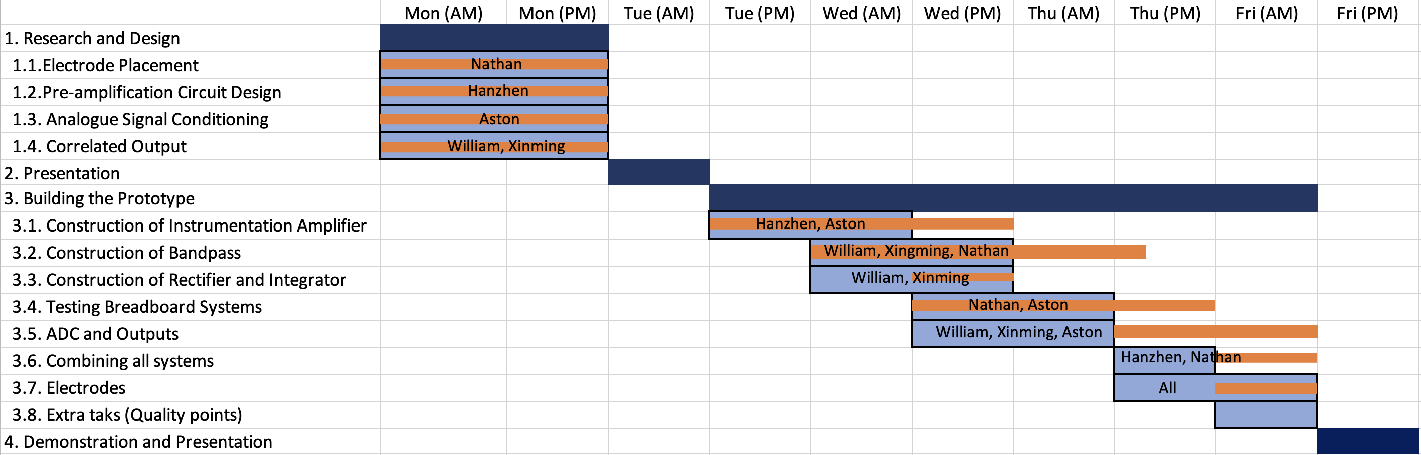
Timeline and Contribution
Aston
Gantt chart showing timeline and team contributions

Slide 7
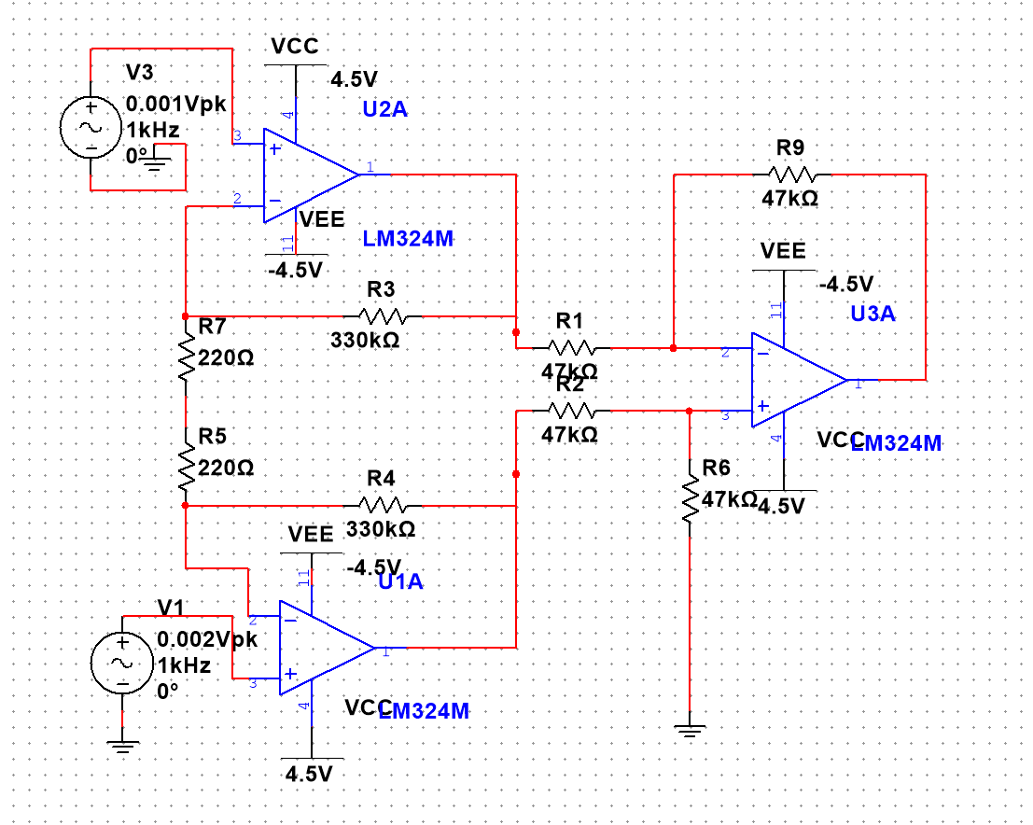

Pre-Amplifier
In the real experiment, we choose amplifier LCM660
The gain of this circuit can be derived:
For example, if we want the gain=1500, we can choose:
R3=R5=47k ohm
R3=330k ohm
R5=220 ohm
So the choice of resistors we use are:
R1=R2=R9=R6=47k ohm, R3=R4=330k ohm, R5=R7=220 ohm
9

Slide 8
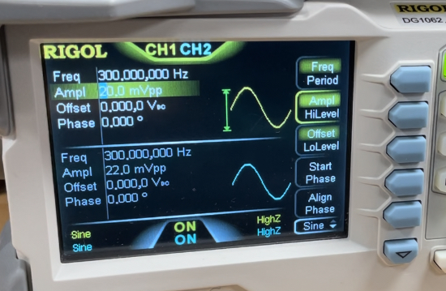
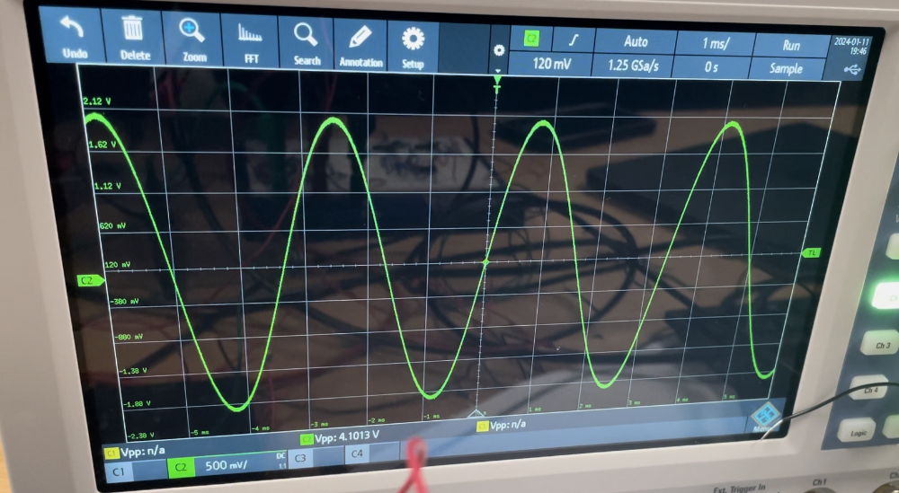
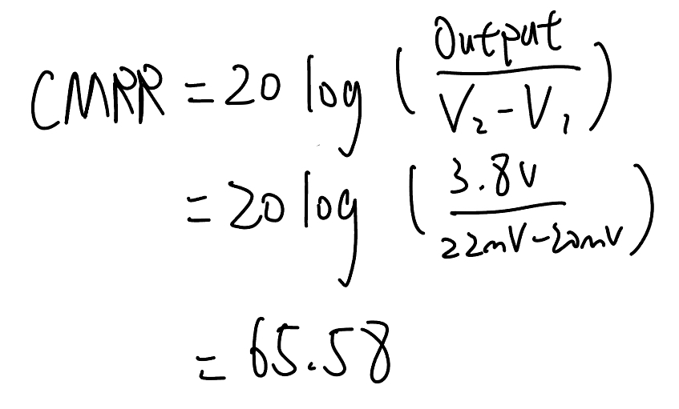
Pre-Amplifier
When we testing the pre-amplifier circuit, we chose following parameters:
Frequency of two signals=300Hz
V1=20mV
V2=22mV
V2-V1=2mA with frequencies both 300Hz, which is going to simulate the electric signals across human being's skin. The result will be stable around 3.8V, which can be our desired output from the pre-amplifier.
The Common Ratio Rejection Rate:

Slide 9
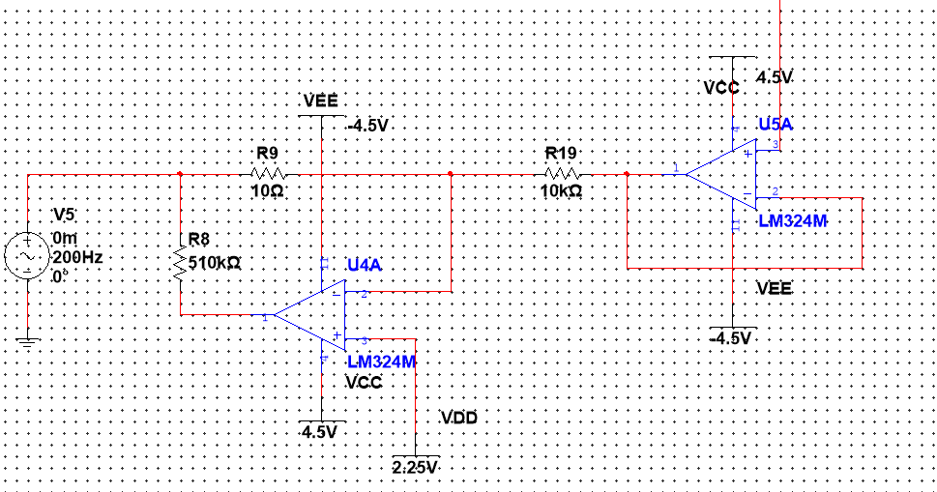
Pre-Amplifier (DRL circuit).
The use of DRL has been suggested to eliminate the interferences by active cancellation:​
DRL circuit with full name: Driven Right Leg circuit, which is a circuit that drive the interference signals back to human body.
​This circuit is not contained in our circuit.

Slide 10
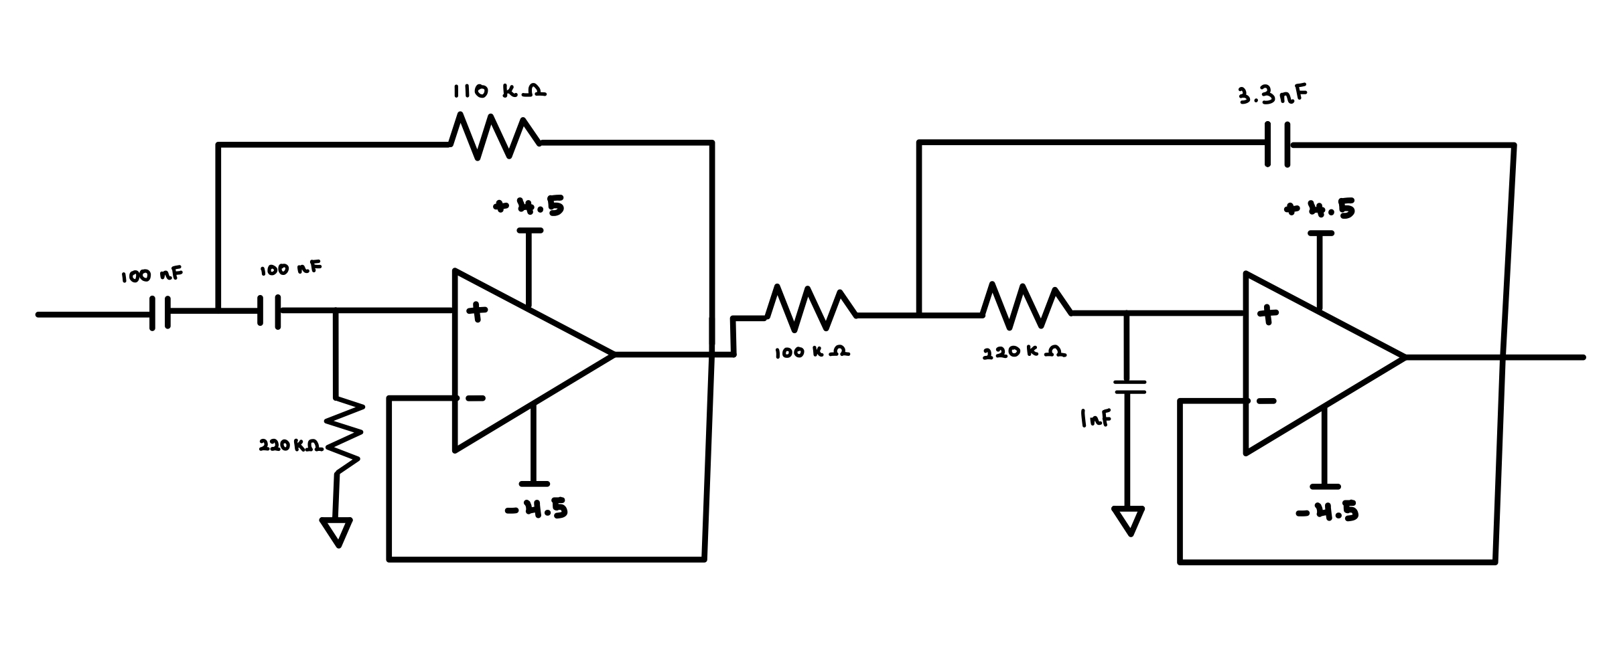
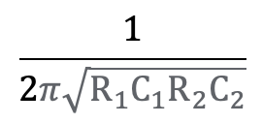
Bandpass Filter
Components:
2 x 100 Ω Resistors
1 x 10 Ω Resistor
2 x 220 Ω Resistors
2 x 100 nF Capacitors
1 x 1 nF Capacitor
1 x 1 3.3 nF Capacitor
LM324N Op-amps
Filters signals in between the bandwidth of sEMG (10 – 500 Hz)
Contains a Low-pass and a High-pass filter
Both filters use the second-order Sallen key configuration to prevent loss in voltage
High-pass
Low-pass
Cutoff frequency =
Circuit of Bandpass filter

Slide 11
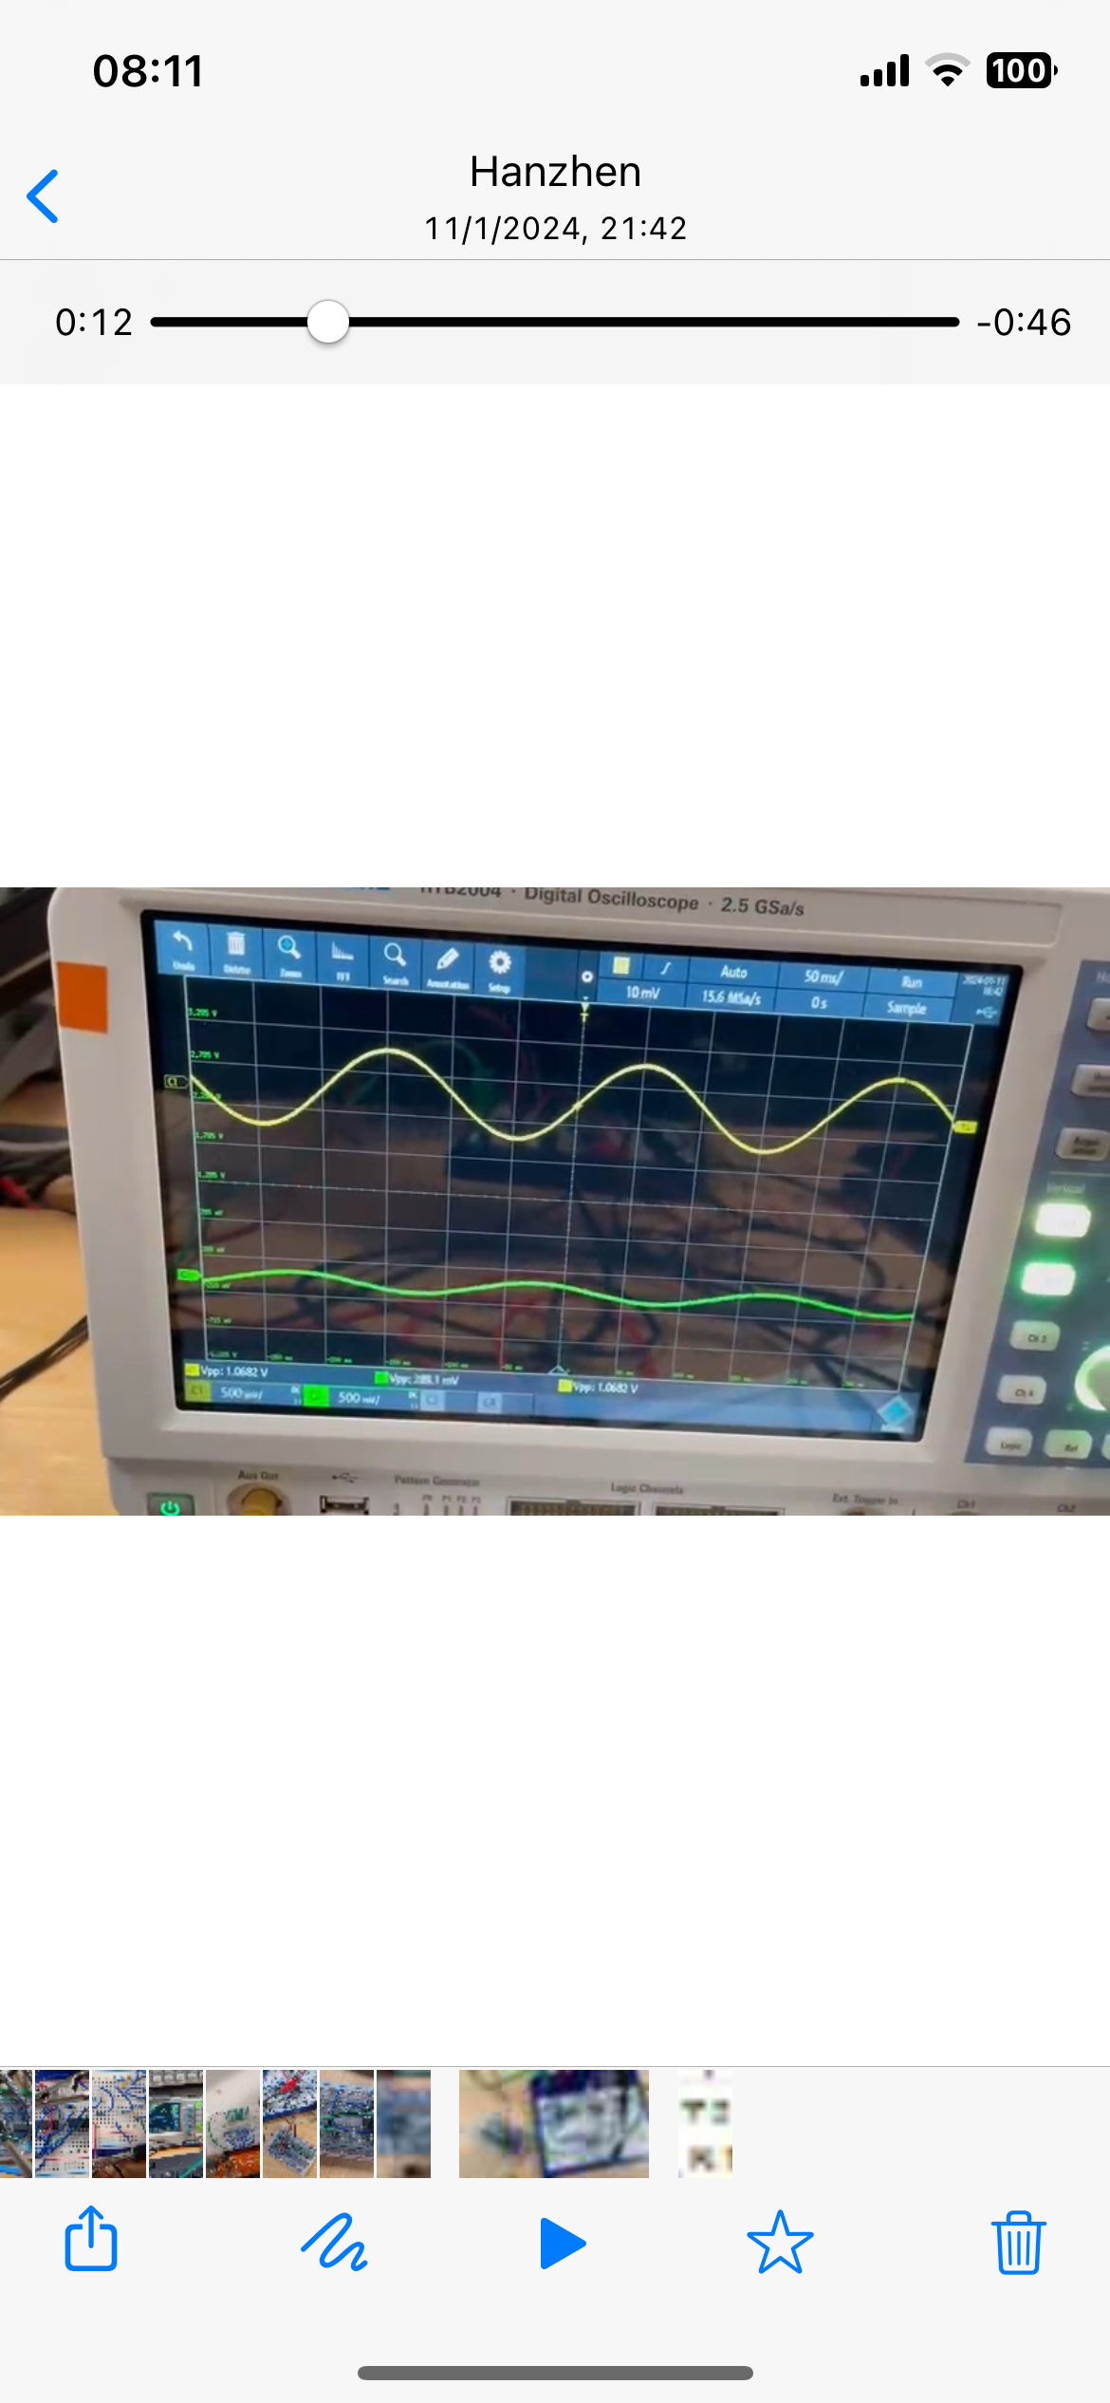
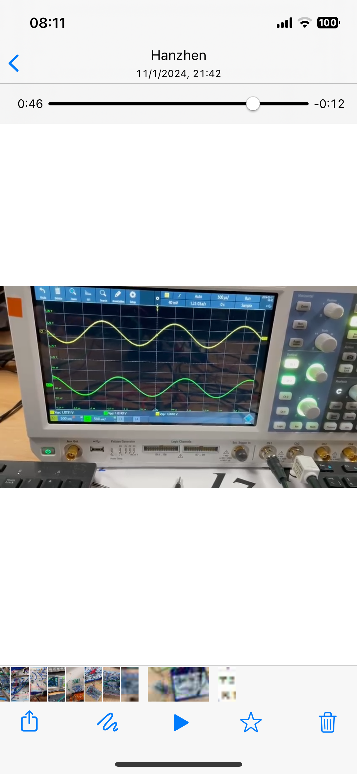
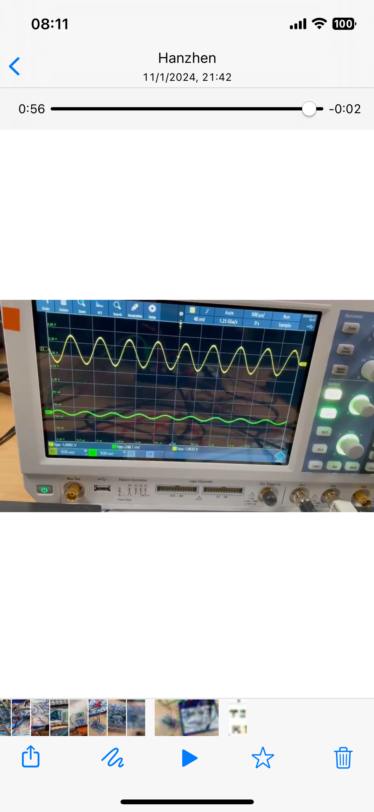
Testing Bandpass Filter
Input connecting to signal generator producing sinusoidal wave
Output connected to oscilloscope
Starting from 1 Hz, increase the frequency
Waveform at 5 Hz
Waveform at 450 Hz
Waveform at 1000 Hz

Slide 12
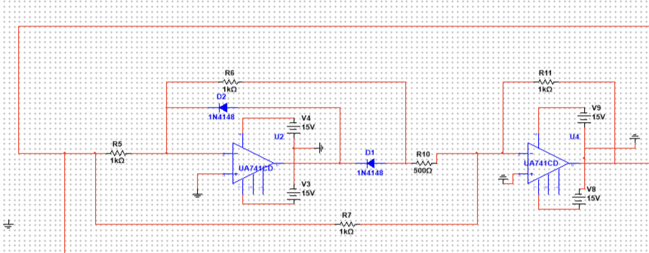
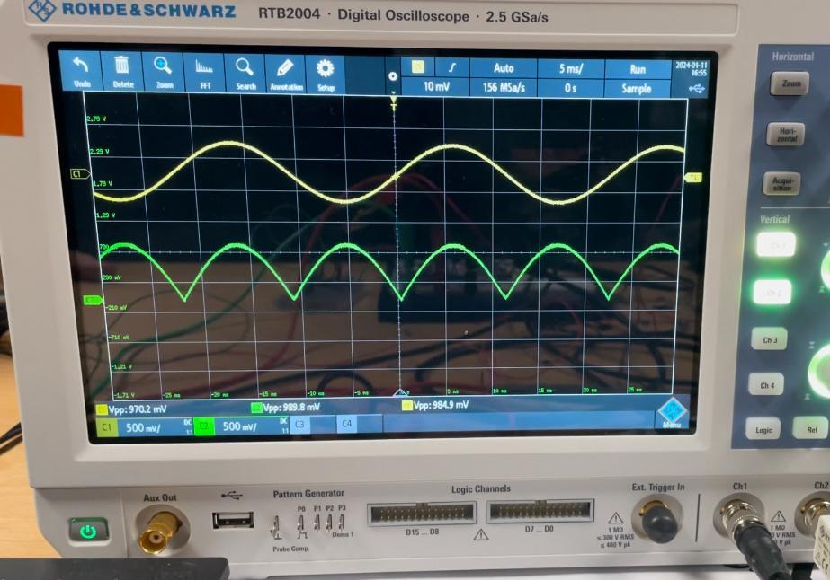
Rectifier
Full wave precision rectifier which produces continuous ripple wave on the negative side of the x-axis.
Circuit design of the Rectifier
Full wave rectifier have much less power loss than the half wave rectifier.
Components:
3x 1k Ω resistors
1x 0.5k Ω resistor
2x Zener Diode (BZX79)
1x LM324N(2/4 op-amp used)
Output of the Rectifier on the oscilloscope

Slide 13
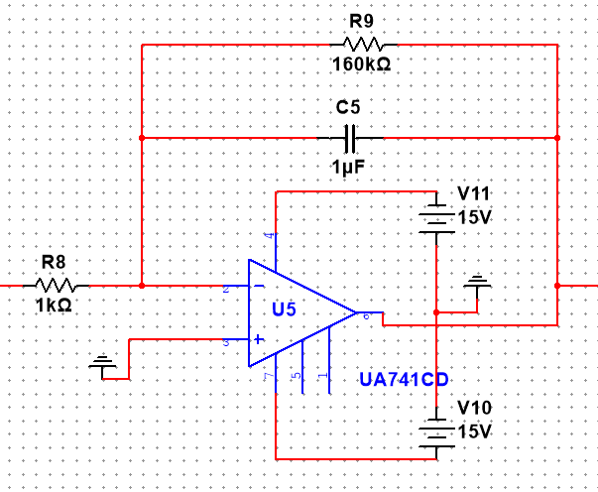
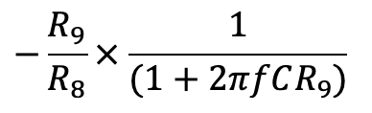
Integrator
Components:
1x 160k Ω resistor
1x 1k Ω resistor
1x 1 µF capacitor
1x LM324N(1/4 op-amp used)
The integrator makes a 180 degrees phase shift on the input signal.
The corner frequency is between 1-2 Hz as it is the frequency of muscle activation
The corner frequency = 1/(2*π*160kΩ*1µF) = 1Hz
The AC gain is given by:
The value of R₁ is chosen to minimize voltage loss
Circuit design of the Integrator

Slide 14
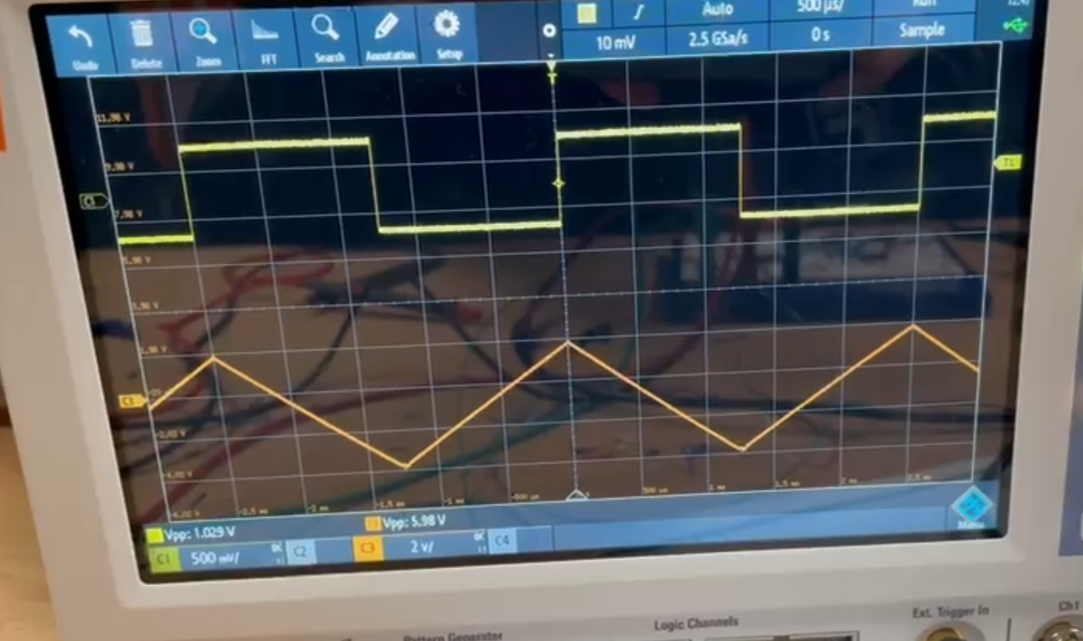
Testing Integrator
Input is connected to a signal generator producing a square wave
Output is connected to an oscilloscope which shows a ramp
Output of the Integrator on the oscilloscope

Slide 15
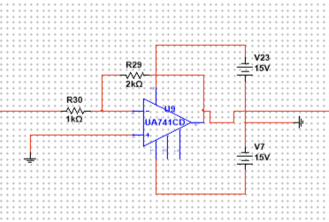
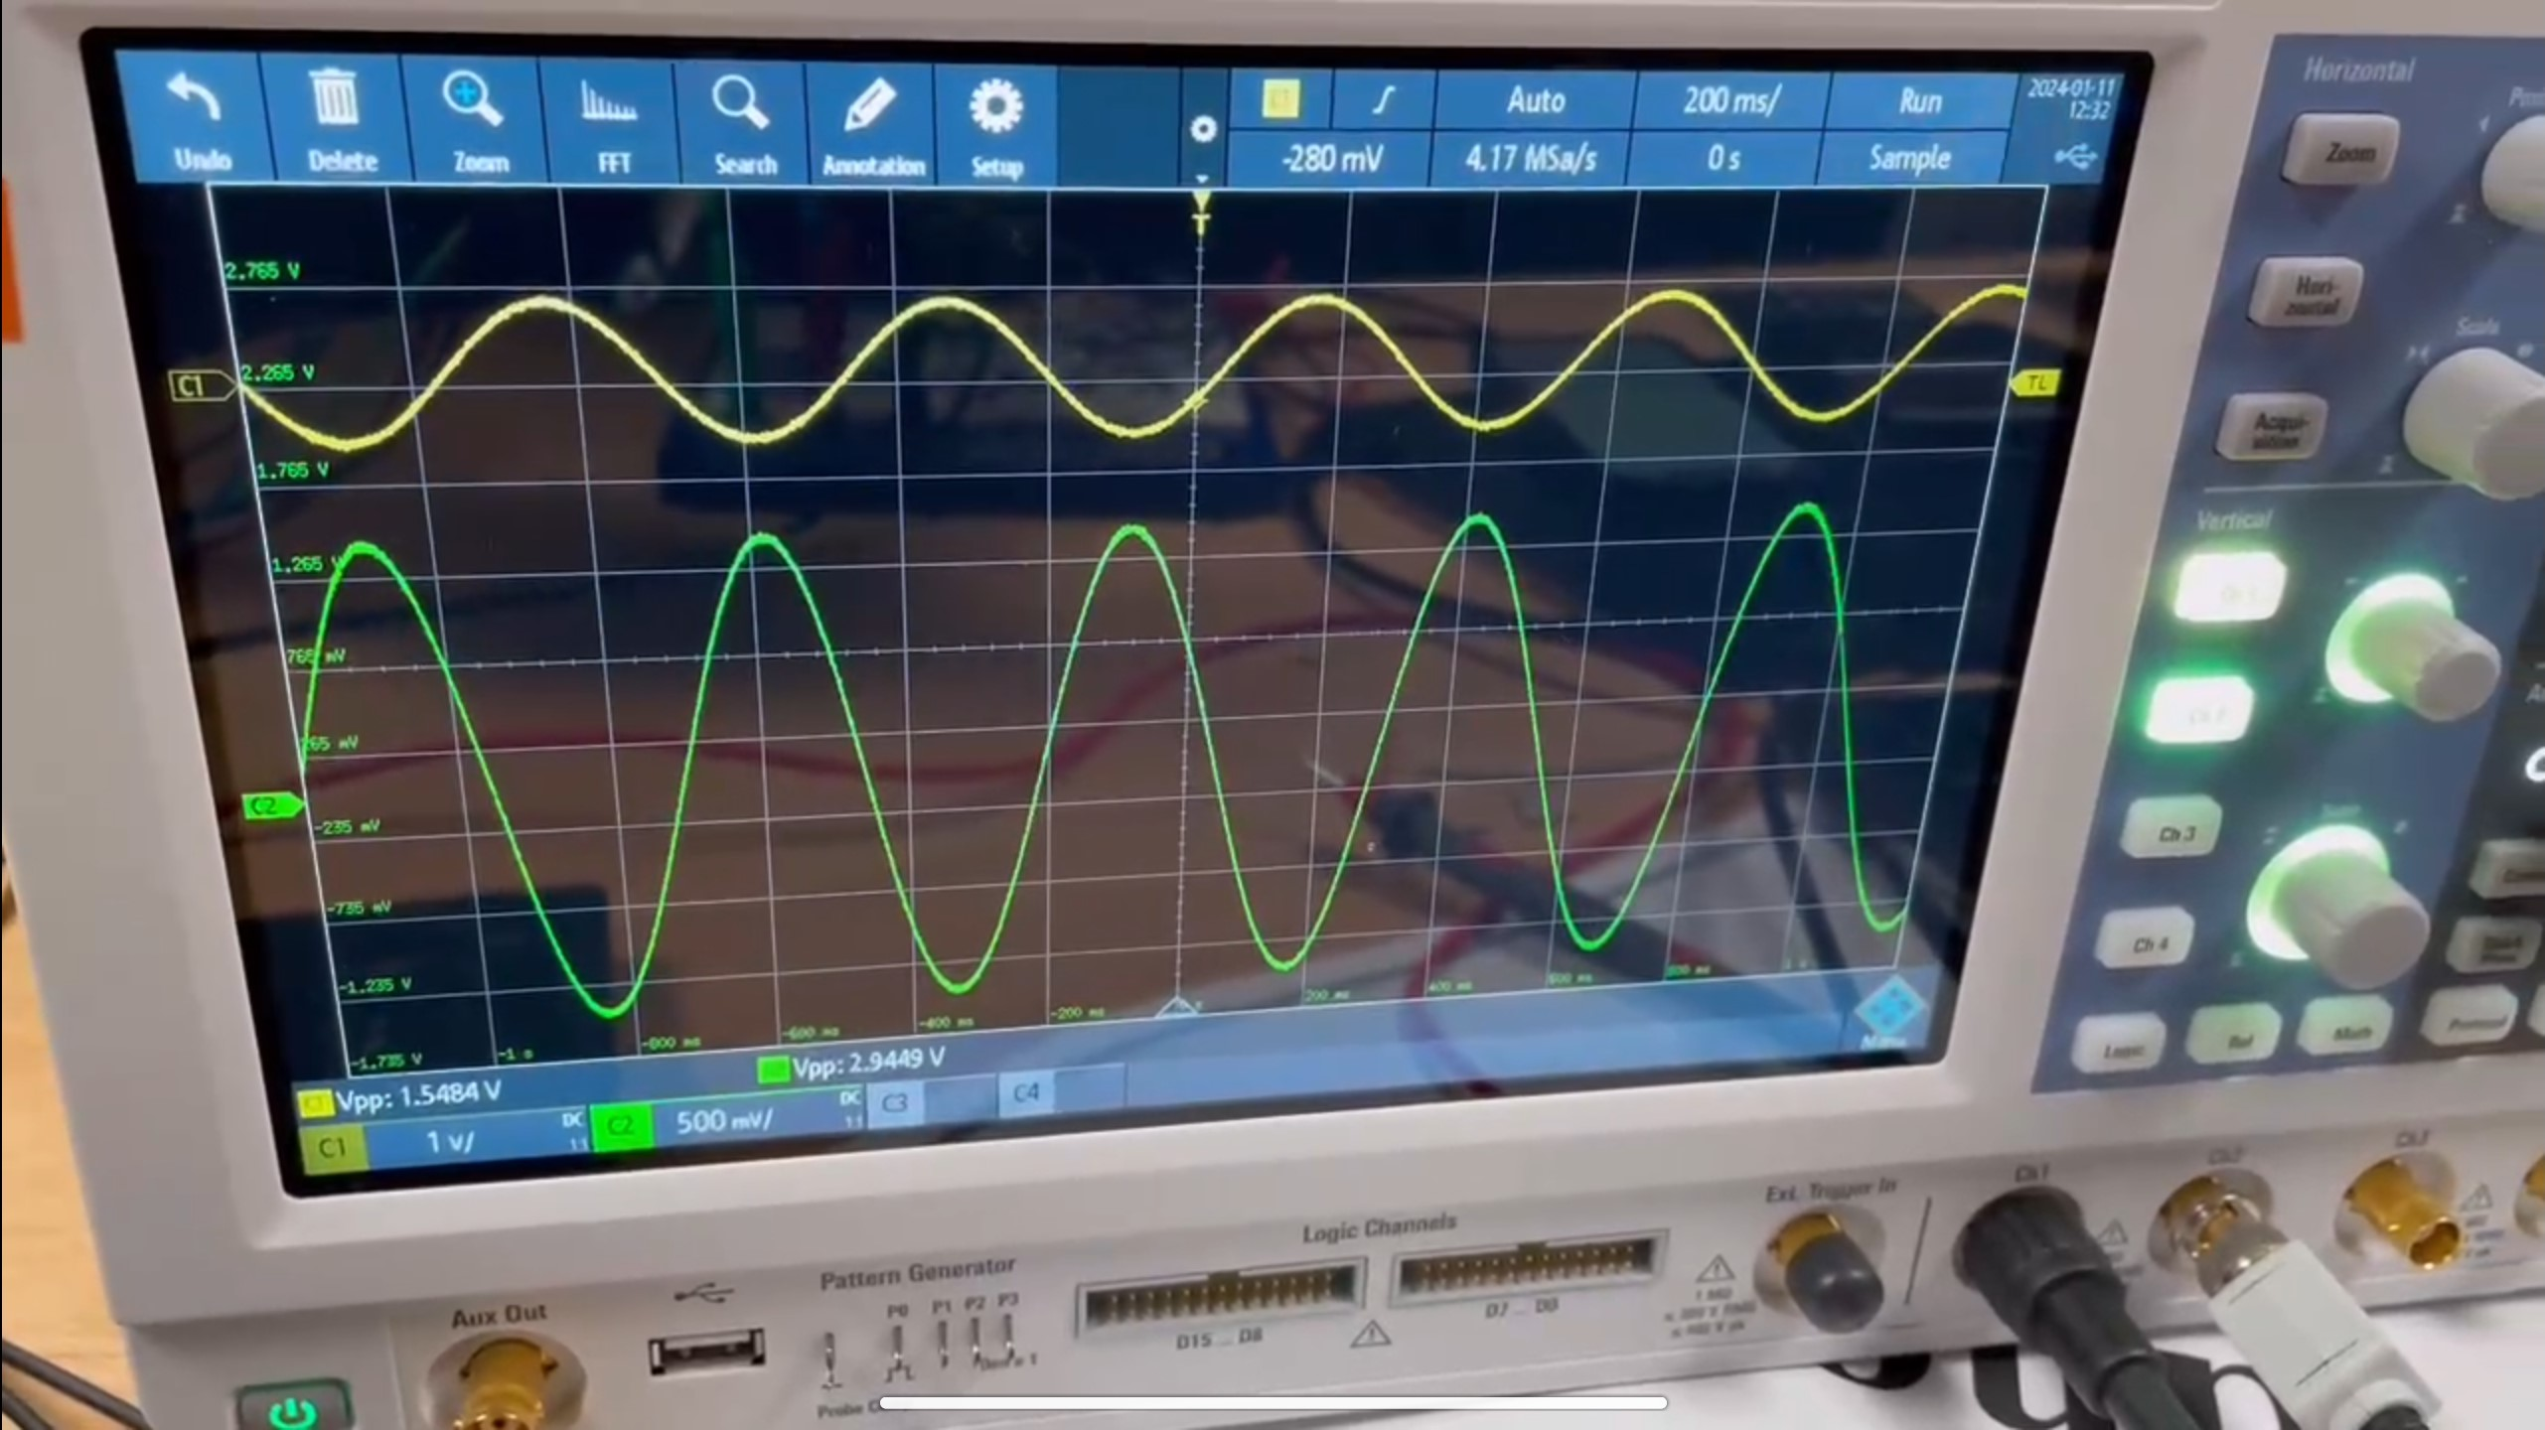
Extra Amplifier
An inverting amplifier which will make a 180 degrees phase shift on original signal or produce an antiphase signal.
Circuit design of the Extra Amplifier
Components:
1x 1k Ω resistors
1x 2k Ω resistor
1x LM324N(1/4 op-amp used)
Output of the Extra Amplifier on the oscilloscope

Slide 16
Arduino and ADC
Codes:
void setup() {
// Initialize serial communication at 9600 bits per second:
Serial.begin(9600);
}
void loop() {
// Read the input on analog pin 0:
int sensorValue = analogRead(A0);
// Convert the analog reading (which goes from 0 - 1023) to a voltage (0 - 5V):
float voltage = sensorValue * (5.0 / 1023.0);
// Print out the value you read:
Serial.println(voltage);
}

Slide 17
Arduino and ADC
Codes of ADC explanation:
1.'void setup()': This is the initialization part of the Arduino program and is run once at the beginning of the program. Here, serial communication is initialized to 9600 baud rate.
2.'int sensorValue = analogRead(A0);': Read the value of the analog signal from analog pin A0 and store it in an integer variable 'sensorValue'.
3.'float voltage = sensorValue * (5.0 / 1023.0);': Convert analog readings to voltage values. The Arduino's analog reading range is 0 to 1023, which corresponds to a voltage range of 0 to 5V. This line of code maps analog readings to corresponding voltage values. This part converts analog to digital values.
4.'Serial.println(voltage);': Send the calculated voltage value to the serial monitor through serial communication for viewing on the computer.

Slide 18
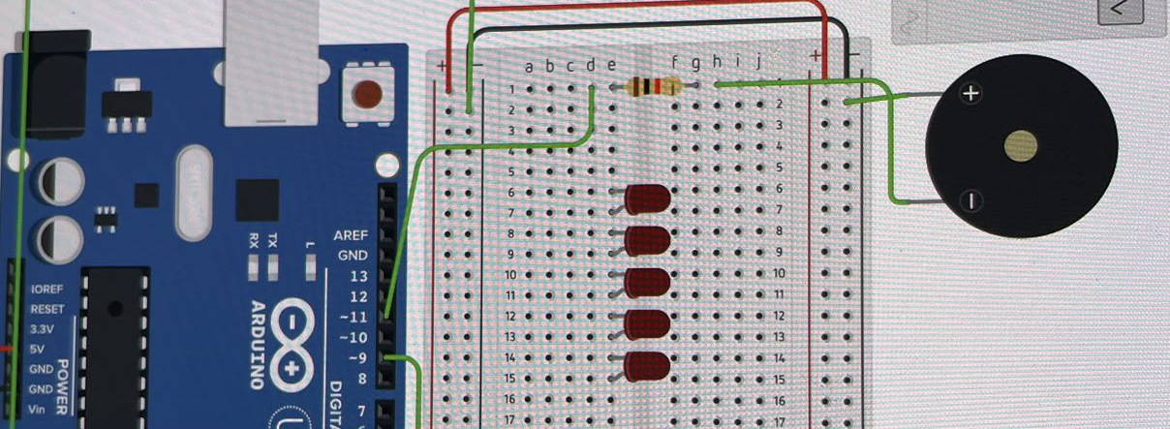
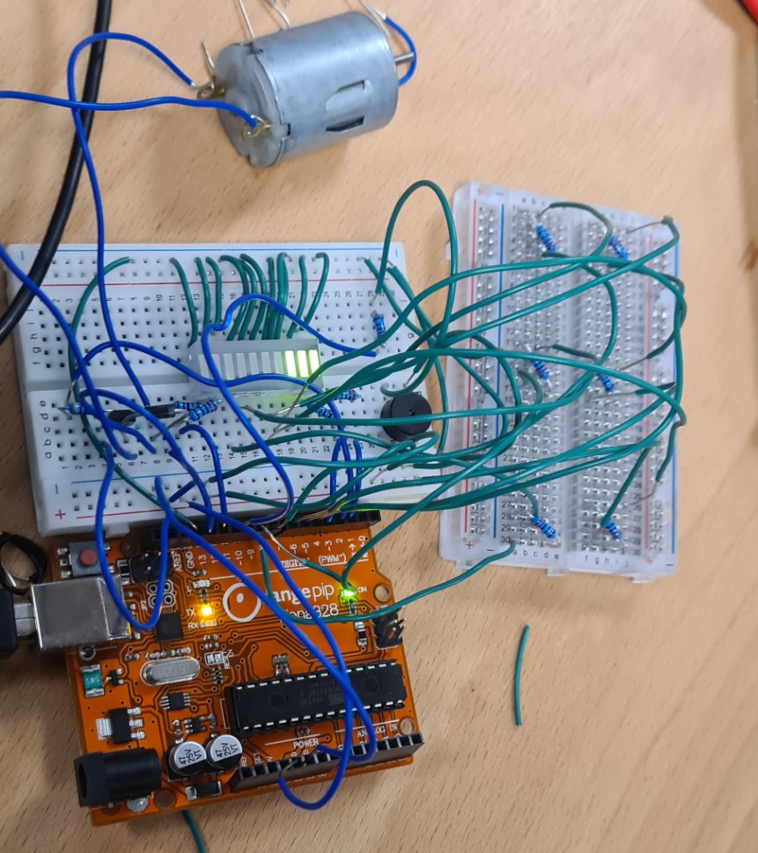
Output (Buzzer)
PWM output pin 11 connected to a series resistor to buzzer.
Uses current limiting resistor
Buzzer second terminal connected to the positive rail connected to 5V supply of Arduino
Components:
1× 220Ω resistor
1x Arduino Uno
1× Buzzer
Testing
Signal generator generates sine input going into A0 pin of Arduino
Observe buzzer's response volume to different input amplitudes

Slide 19
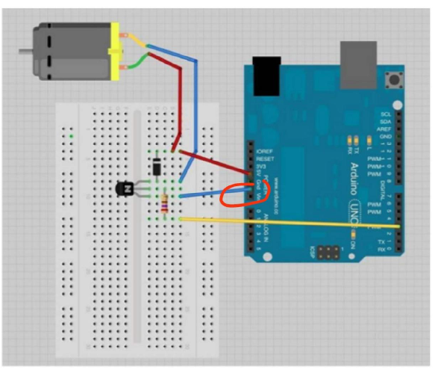
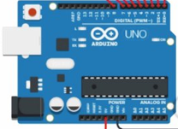
Output (Motor)
const int motorPin = 3;
void setup() {
pinMode(motorPin, OUTPUT);
}
void loop() {
int sensorValue = analogRead(sensorPin);
int motorSpeed = map(sensorValue, 0, 1023, 0, 255);
analogWrite(motorPin, motorSpeed);
delay(100);
}
Components:
1x 270 Ω
1x NPN Transistor ()
1x Zener Diode (1N4148)
1x Motor
1x Arduino Uno
Operating voltage: 1.5 to 6.0V DC
Rated Load Current: 0.65A
Rated Load Voltage: 3V
Resistor Value = (V_arduino-VBE)/I_Base
Yellow: PWM pin to input
Red: 5V power supply from Arduino
Blue: Ground from Arduino
Testing
Signal generator generates sine input going into A0 pin of Arduino
Observe motor's response speed to different input amplitudes

Slide 20
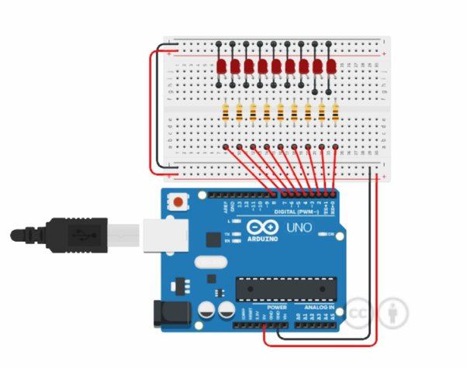
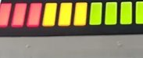
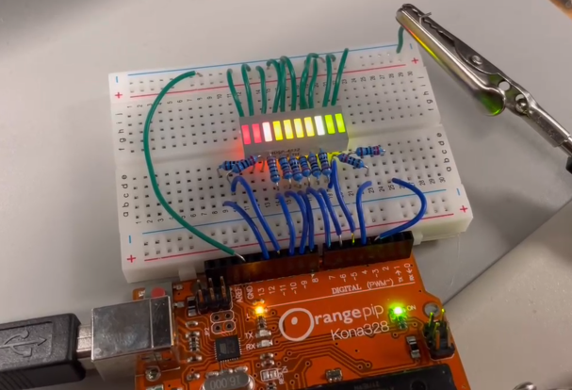
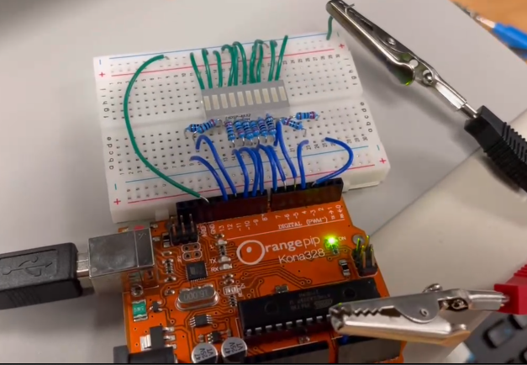
Output (LEDs)
Testing
Signal generator generates sine input going into A0 pin of Arduino
Observe LED's response to different input amplitudes
Increasing input voltage increases number of bars lit from green to red
const int sensorPin = A0;
const int numLEDs = 10;
int LEDpins[numLEDs] = {3, 4, 5, 6, 7, 8, 9, 10, 11, 12};
const float forwardVoltage = 2.0;
const float forwardCurrent = 20.0;
const int transistorPin = 13;
void setup() {
Serial.begin(9600);
for (int i = 0; i < numLEDs; i++) {
pinMode(LEDpins[i], OUTPUT);
}
pinMode(transistorPin, OUTPUT);
float resistorValue = (5.0 - forwardVoltage) / (forwardCurrent / 1000.0);
Serial.println(resistorValue);
}
void loop() {
int sensorValue = analogRead(sensorPin);
int numLitLEDs = map(sensorValue, 0, 1023, 0, numLEDs);
for (int i = 0; i < numLEDs; i++) {
digitalWrite(LEDpins[i], i < numLitLEDs ? HIGH : LOW);
}
digitalWrite(transistorPin, numLitLEDs > 0 ? HIGH : LOW);
}
Components:​
-​ 10x 220 Ω Resistors
-​ 1x 10 Way LED Bar
-​ 1x Arduino Uno
Black = Ground
Red = 5V power from Arduino
High Input Voltage
Forward Current: R 90mA, Y 60mA, G 90mA
Forward Voltage:
R 2.1V, Y 2.2V, G 2.1V
Low Input Voltage

Slide 21
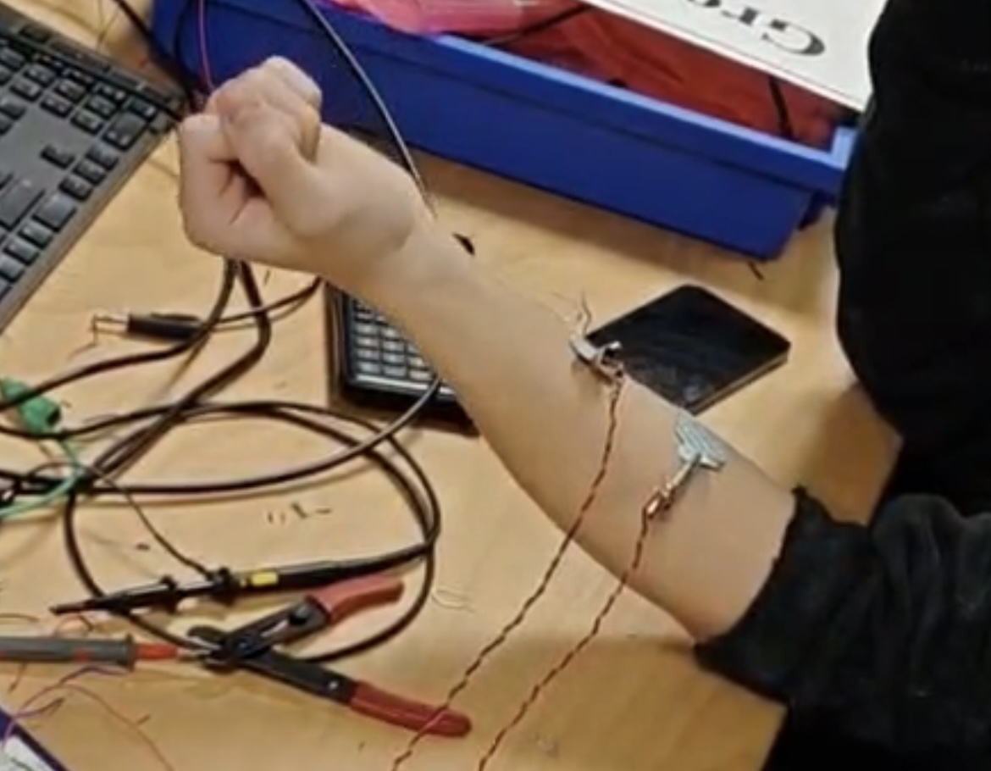
Electrode Placement
The optimal placement for the electrodes are on the muscle belly
Two electrodes are required on the muscle to minimize noise
Two electrodes are placed 2.5 cm apart to balance positioning on the muscle and cross talk
For safety reasons, the electrodes were not tested using the oscilloscope but instead tested with the outputs
Electrode Placement on the
Brachioradialis Muscle

Slide 22
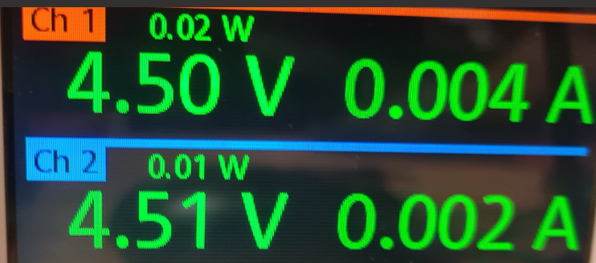
Power Calculations and Costs
Positive Supply Current
Negative Supply Current
Power drawn by Op-Amp = Supply Voltage x Total Supply current drawn
Active Experimental Instruments
4x LM324 Op-Amps (9x individual Op-Amp used)
Total Cost: 4 x £1.50 = £6.00
Total power drawn by Op-Amps= 4 x (0.002+0.004) x 9 = 0.216W
Total power drawn of outputs:
Motor = P = IV = 0.65 A x 3 V = 1.95 W
Buzzer = P = IV = 0.03 A x 3 V = 0.09 W
LED Bar = P = IV = 0.09 A x 2.2 V = 0.198W
Active Theoretical Instruments for maximum efficiency
2x LM324 Op-Amps (8x individual Op-Amps supplied)
1x UA741 Op-Amp
(x9 total individual Op-Amps used)
Total Cost: (2 x £1.50) + (1 x £0.47) = £3.47
Total theoretical power drawn by Op-Amps = 2 x (0.002+0.004) x 9 + (0.003+0.002) x 9 = 0.153W
Total actual power drawn = 0.216 + 1.95 + 0.09 + 0.198 = 2.454 W
Pros
Power efficiency increased
Total cost decreased
Cons
Increases risk of short circuits
Increases greater pick-up of noise through longer wires

Slide 23
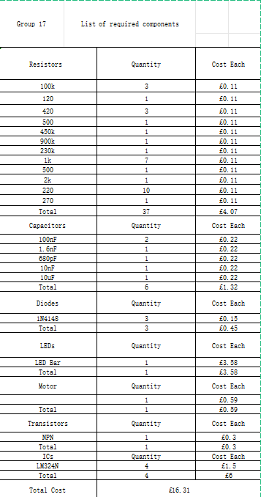
Costing Evaluation
Total components used:
37x Resistors (8x Pre-amplification, 17x Analog Signal Conditioning, 12x Output Circuits)
6x Capacitors (6x Analog Signal Conditioning)
3x Diodes (2x Rectifier, 1x Motor)
1x Motor
1x LED Bar
4x LM324N (1x Pre-amplification, 3x Analog Signal Conditioning)
1x NPN Transistor () (1x Motor circuit)

